Slide 1


Component Analysis on Soft Skills of Prospective Employees

Slide 2
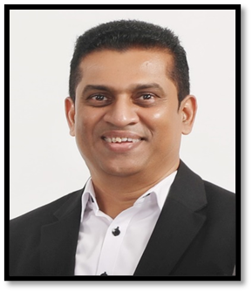
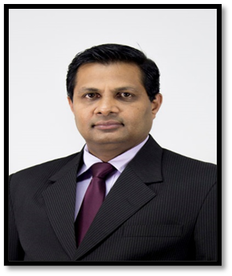
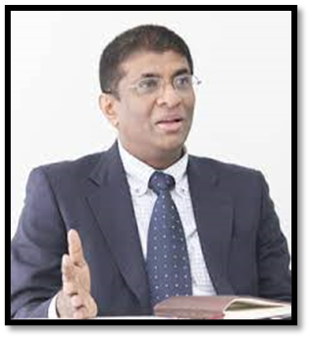
Supervisors
Dr. Shanta Yapa
Supervisor
Prof. Samantha Telijjagoda
Co-Supervisor
Prof. Nishantha Giguruwa
External Supervisor

Slide 3

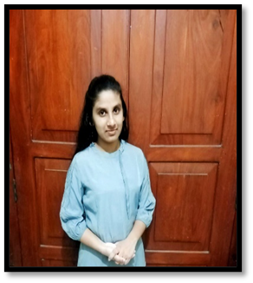


Team Members
Jayawardhana B.P.W
IT20600570
Member
IT20624330
Premathilaka M.A.D.M
Leader
IT20298258
Jayamannna H.E.
Member
Thennakoon T.M.S.K.S
IT20614980
Member

Slide 4

Introduction
There are frequently mismatches between job searchers and open opportunities as a result of the historically labor-intensive job matching process.
Artificial intelligence must be used to develop proactive job seeker techniques in order to meet this challenge.
Furthermore, even while recruiters might have excellent technical skills, supervisors might not always find their soft skills up to par.
We have decided to use AI to evaluate recruiters' soft skills in addition to their technical and general competence, which is why we have created a simple application.

Slide 5


Objectives
Identifying and Analyzing algorithms that can accurately evaluate job seekers' skills and match them with opportunities that fit their soft skills rather than their qualifications

Slide 6
Sub Objectives
Studying the recruiters' ability to concentrate on academic tasks.
Evaluating the recruiters’ compressive analysis.
Examines the recruiters' initiative and motivation to take-action.
Analysis videos for non
Verbal Communication

Slide 7

Concentrate Analysis
Premathilaka M.A.D.M
IT20624330

Slide 8

Research Problem
What are the key soft skills and cognitive abilities that contribute to employees' enhanced concentration, attention span, and focus on the workplace, and how can HR management effectively assess and measure these soft skills during the hiring process to select candidates who demonstrate strong abilities in maintaining focus and attention to detail?

Slide 9

Introduction
This is time to taken recruiter's based on their concentrate skills.
Memory Game
Sudoku
Facial Recognition
Assessments Based on the Concentrate Analysis

Slide 10
TOOLS AND TECHNOLOGIES
Backend : Python
Frontend : React Js
Database : MongoDB
DataSets
Algorithms
GIT

Slide 11
Model : VGG16 V1
DataSet: Animal 151

Slide 12
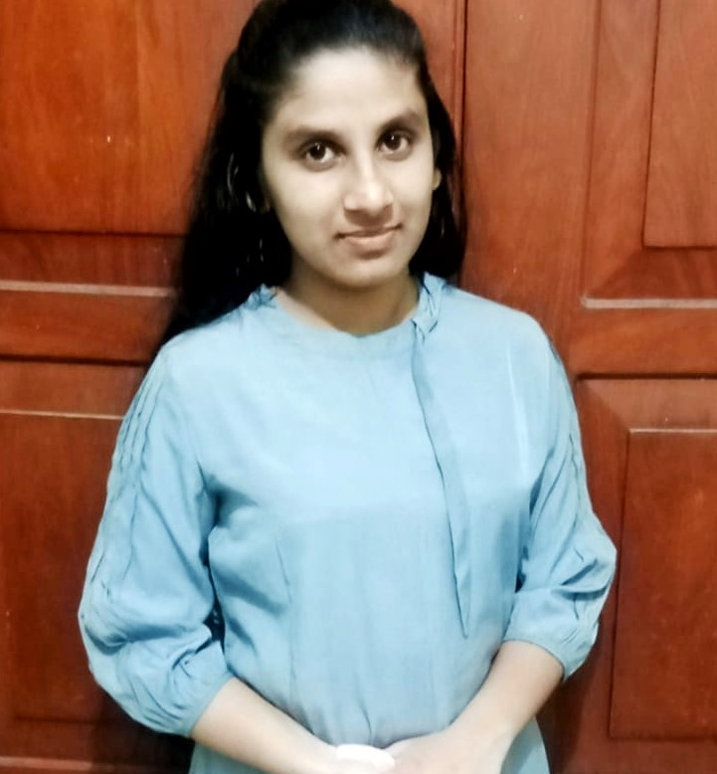
COMPREHENSION Analysis
Jayamanna H.E
IT20298258

Slide 13
Introduction
Research Problem
Background
Methodology
Overview Diagram
Progress of Project
Tools and Technologies
Objective and sub objectives
Benefits for future

Slide 14
What is Comprehension Analysis ?
A reader tries to reconstruct a message encoded in graphic language.
The Comprehension Analysis for job seekers is an innovative application designed to assist employers in making informed and accurate hiring decisions.
This application employs advanced AI-driven techniques to assess a job seeker’s reading comprehension and skill of identifying the any passages.

Slide 15
Research Problem
There may be some problems in the communication ability of the job candidates, in understanding each other's ideas.
This may cause various problems in the workplace as well as in the position. This is trouble of company.

Slide 16
Background
There is two components of reading comprehension. Text comprehension and vocabulary knowledge.
Vocabulary knowledge is the ability to understand the language being used, while text comprehension is using this language to develop an awareness of what the meaning is behind the text.

Slide 17
Benefits of good reading Comprehension Skills
Being able to understand, analyze and respond to documents and written communication in the workplace.
Improve ability to write clearly and effectively.
Better enjoyment and motivational to read.
Increased ability to focus on reading for an extended period.

Slide 18
Methodology
Job seeker has to face reading test during one hour.
Step 1 -: Job seeker select a paragraph and Language.
Step 2-: Test start and Display average question paper on the screen.
Step 3-:Start and answer the questions.
Step 4-:Analysis the Comprehension level.
(Display the score as a percentage on the screen.)

Slide 19
Continue this process, alternating between foundation and advanced-level questions, until all questions are answered or until the test duration is over.
Step 5 -: Test Completion.
Step 6-: Calculate the total marks based on the number of answers.

Slide 20
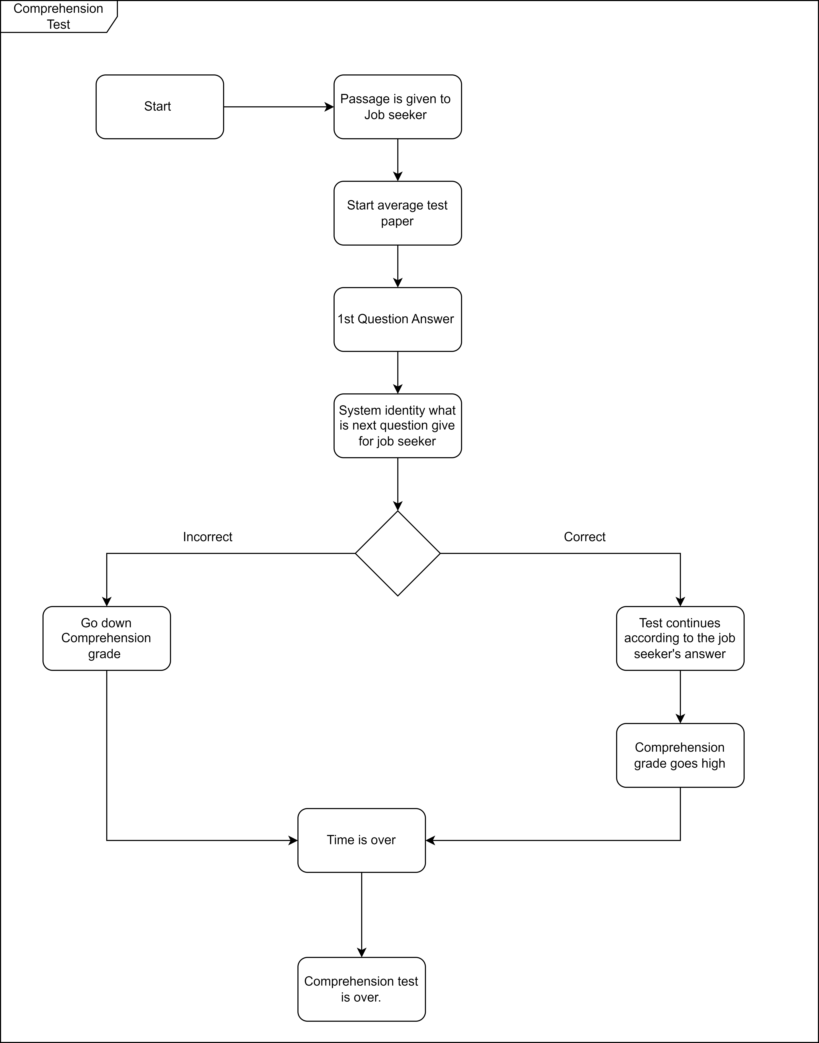

Slide 21
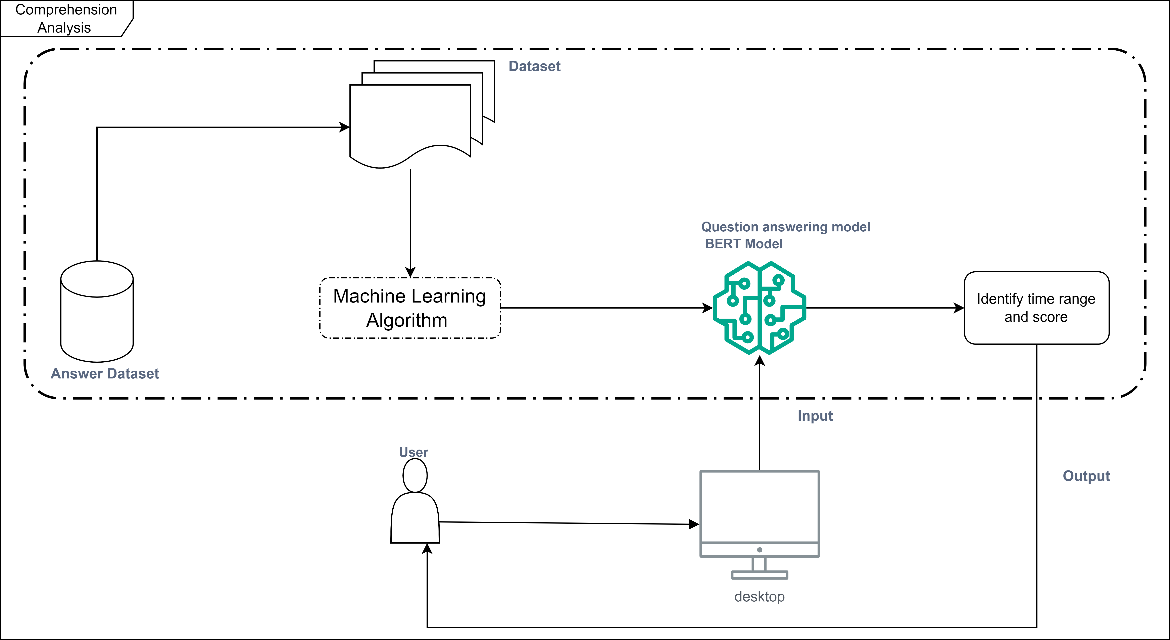
Overview Diagram

Slide 22
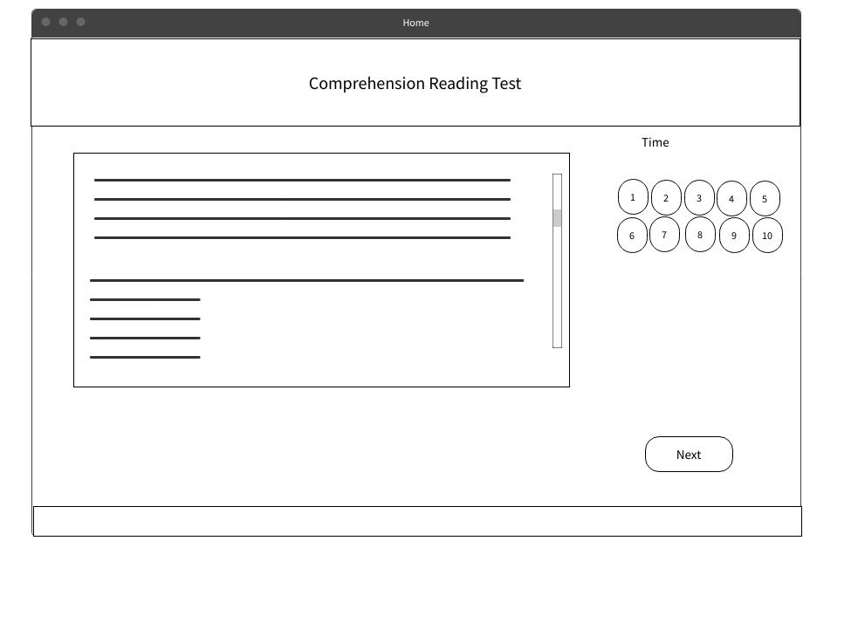
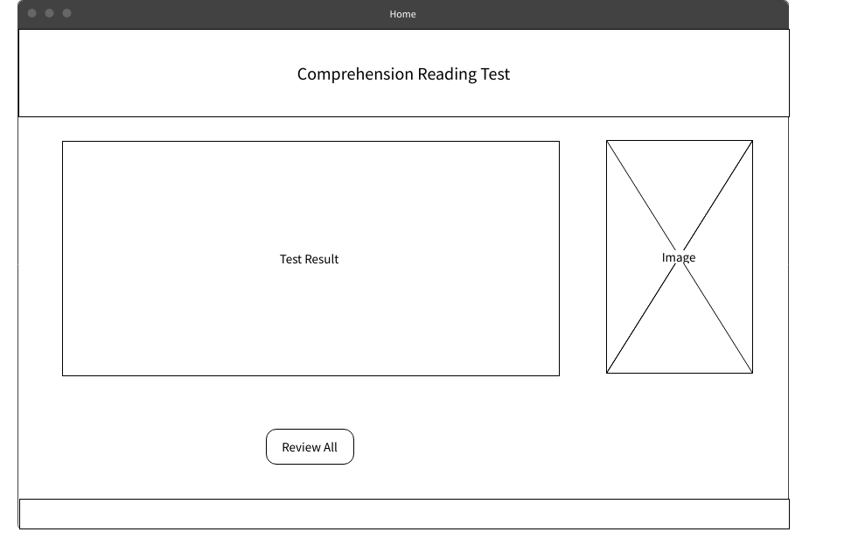
Finally, After creating this website, the Comprehension Analysis page will look like below.

Slide 23
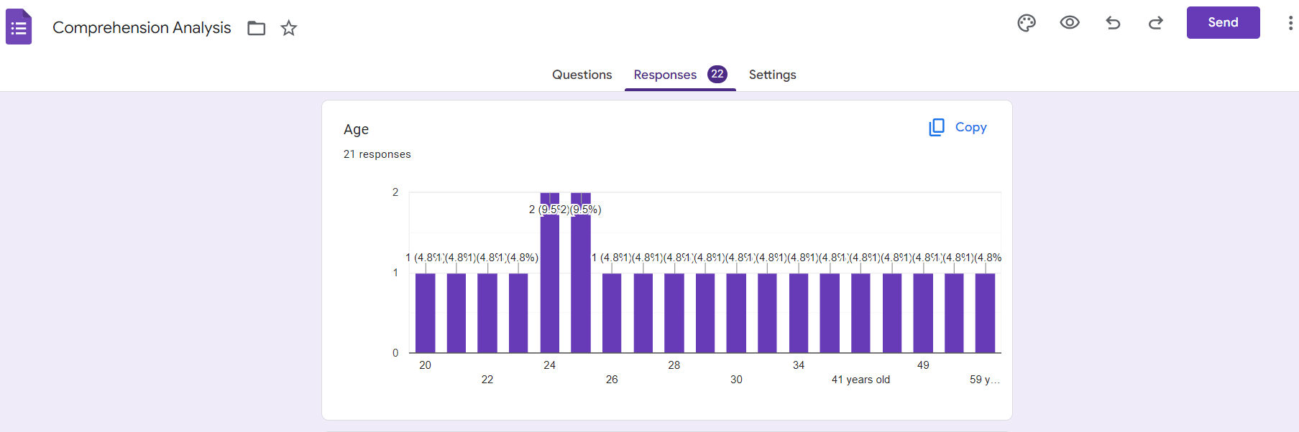
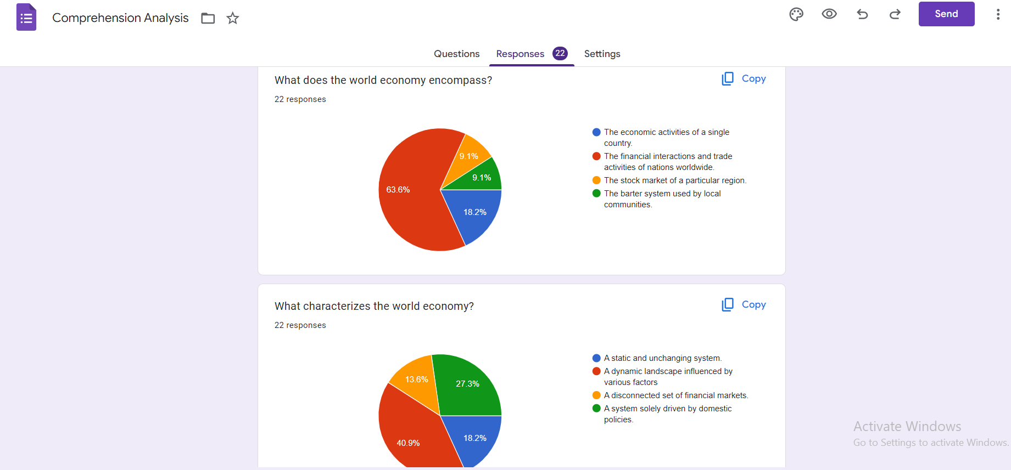
Progress of Project

Slide 24
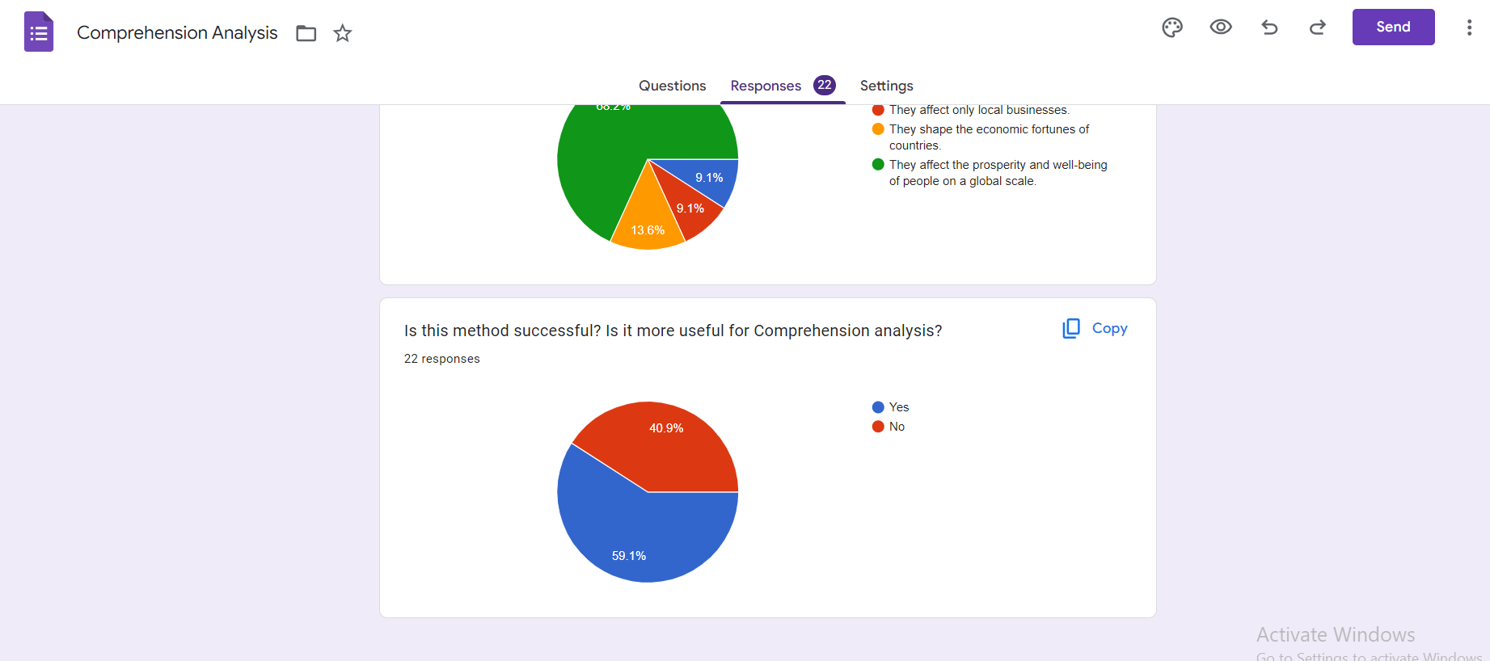
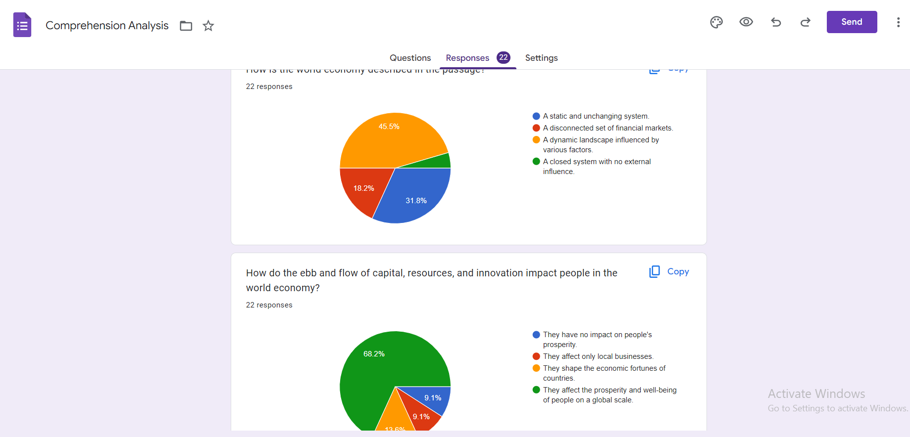
Progress Of Project

Slide 25
Progress Of Project
Logistic Regression - It can be use for predicting whether a job seeker is a good match for a specific job.
Word Embedding - Word2Vec , Glo Ve or FastText
Transformers – Sentiment Analysis , document classification and entity recognition.
Ex :- BERT and GPT-3
Combining multiple models, such as Random Forest, SVM, and deep learning models, can often improve the overall performance.

Slide 26
Tools and Technologies
AI tools
Natural Language Processing (NLP)
Data Analytics Tools
Python – Backend Development
React – Frontend Development
My SQL – Database Management
Azure – Cloud Platform
GIT – Version Controlling

Slide 27
Objective and Sub Objectives
Objectives
The design and development process aims to create a user-friendly application that allows applicants to effectively assess their comprehension.
Sub Objectives
• Assessment and comprehension
Strengths and Weaknesses Customized Teaching Strategies
Progress Tracking
Supporting Educational Decisions
Feedback Loop

Slide 28
Benefits for future
Improved Hiring Process - identify candidates with a strong understanding of relevant technical concepts and industry-specific knowledge.
Better Quality Candidates in the company - perform their roles effectively, leading to higher-quality hires.
Time and Cost Savings - can save time and resources in the hiring process by focusing on the most promising candidates.
Reduced Training Costs - reduce the need for extensive training, saving the company time and money.

Slide 29
Video analysis for Non-verbal communication
Jayawardhana B.P.W
IT20600570

Slide 30
Introduction
Most of companies in the present focus only Knowledge
But some employees behave bad activities in meetings(physical or online)
prioritize knowledge over behaviors in interviews and meetings

Slide 31
DATA sets
Analyse videos and recordings related to interviews and meetings
I was able to find data and divided them into categories as follows
Bad
Feeding
NOfocus

Slide 32
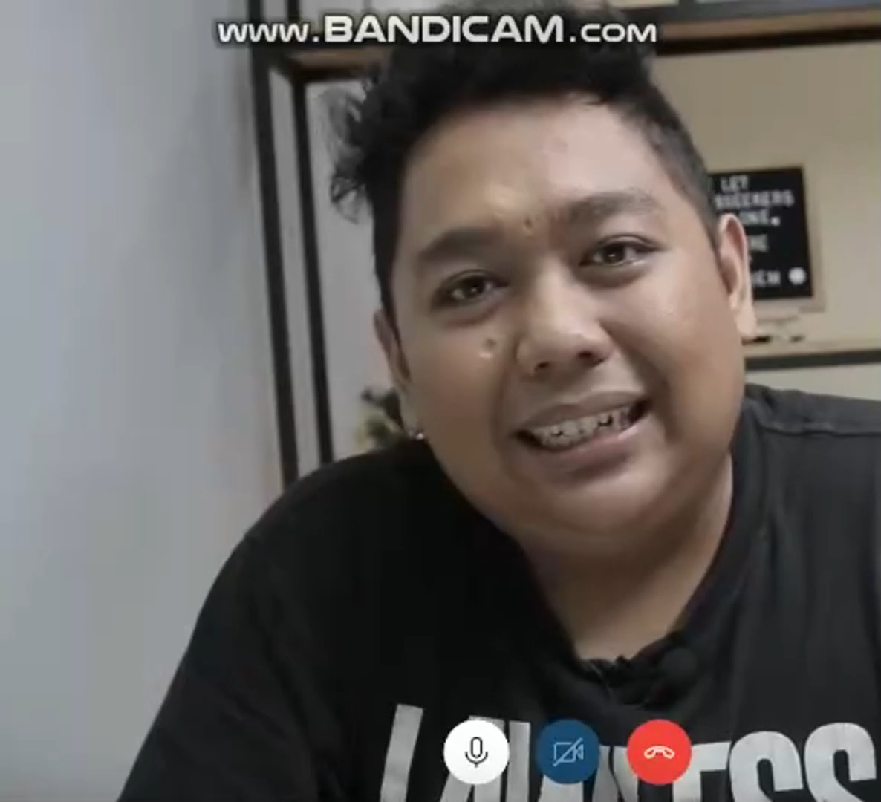
DATA set - BAD
This data set category has behaving bad activities
Such as head scratching

Slide 33

DATA set - Feeding
This data set category has feeding during that time
Such as eating or drinking

Slide 34
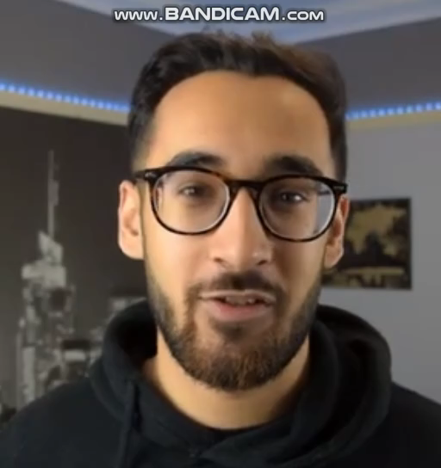
DATA set - NOfocus
This data set category has non focused behaviours
Such as looking around

Slide 35
Mediapipe
Use the mediapipe library to extract features from the videos.
mediapipe library provides a variety of pre-trained models for
Human pose estimation
Face detection
Facial landmark detection

Slide 36
cv2
related to image and video processing.
cv2.imshow(): This function is used to display an image or video frame in a window on the screen.
cv2.destroyAllWindows(): This function closes all the windows that were created by OpenCV.
cv2.VideoCapture(): This function is used to capture video from a camera or a video file. It creates a video capture object that can be used to access video frames.

Slide 37
Algorithms
For training data
Logistic regression
Ridge classifier
Random forest classifier
Gradientboosting classifier

Slide 38
ThanK YOU...

